Slide 1


Let’s Spread Kindness!

Slide 2
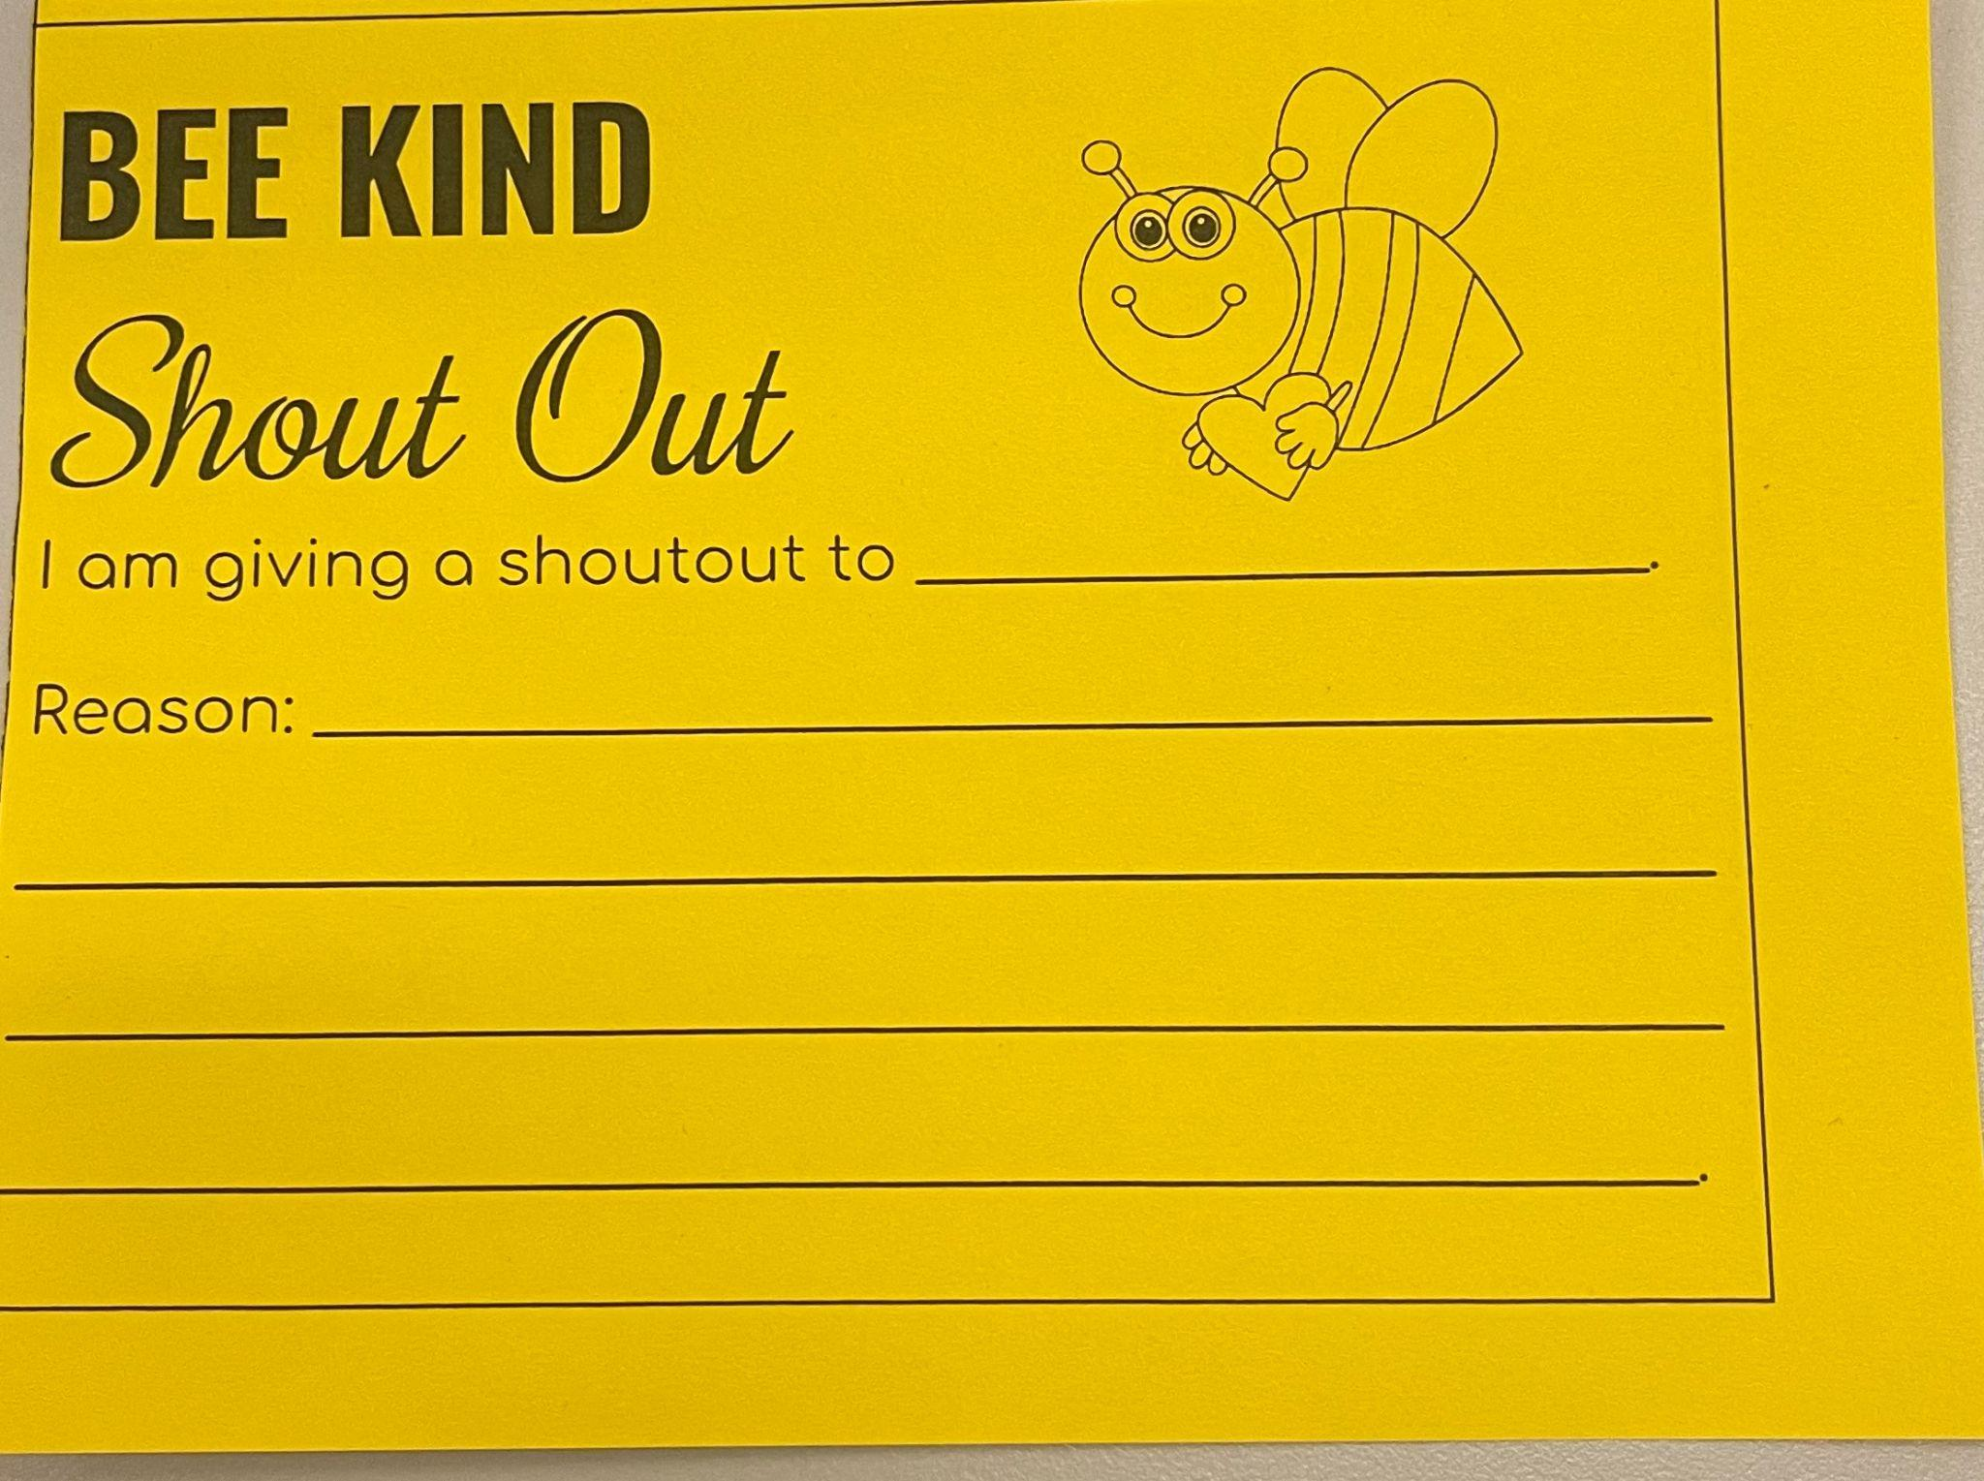
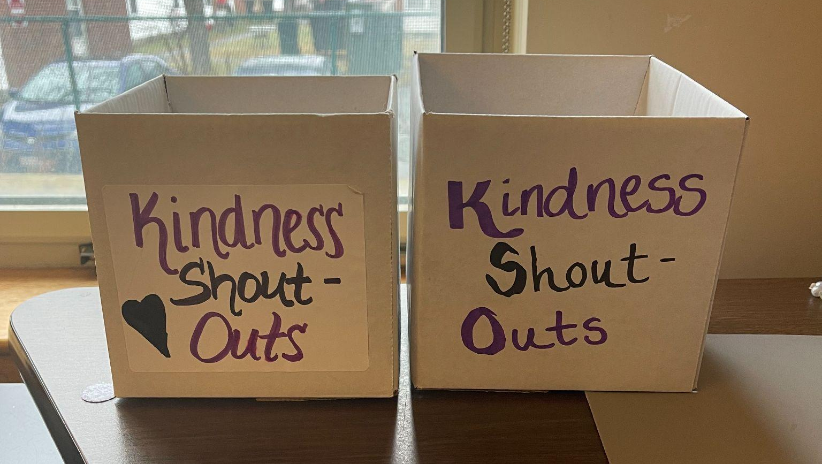
Be Kind!
A special way to share kind words and actions!
Your kindness will be celebrated in school!
The kindness box:
Front Office
Counseling Office
Always available!

Slide 3
How Can You Join?
Write about someone’s kindness on a special kindness paper!
Collect in your classroom
Put it in the kindness box at the front office
Listen to morning announcements in the gym to hear if your kindness was shared!

Slide 4


When?
Kindness shoutouts read once a week in the gym!
You can write and drop it in the box whenever you want!

Slide 5

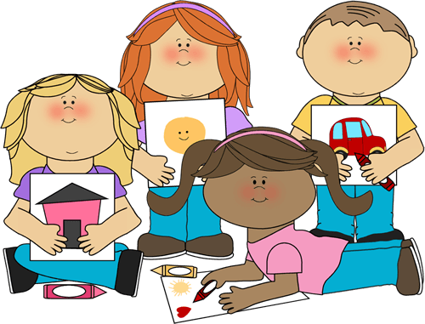


YOU CAN DO IT!

