Slide 1
May 8, 2026
RESPONDING TO CONFLICT
Ms. Winnie!!

Slide 2


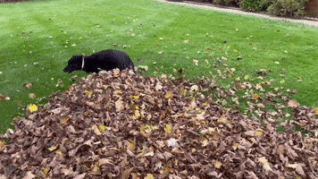









Tools
Tools
Tools
Tools

Slide 3


Hey! I’m Ms.Winnie! :)
I am from Princeton! I went to Riverside, PMS, and PHS!
I’m a new school counselor!
I love yoga, music, playing sports, and dogs
Some of my favorite Princeton spots: Small World Coffee, Halo Pub, Pizza Star

Slide 4
Respect those around you
Try your best
Do not use names
Reminders Before We Begin

Slide 5
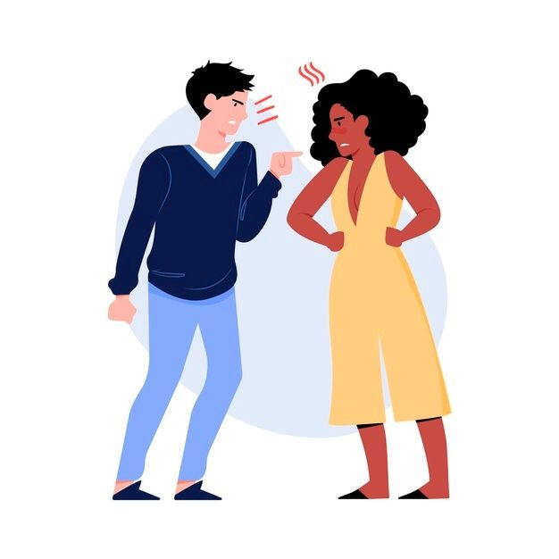
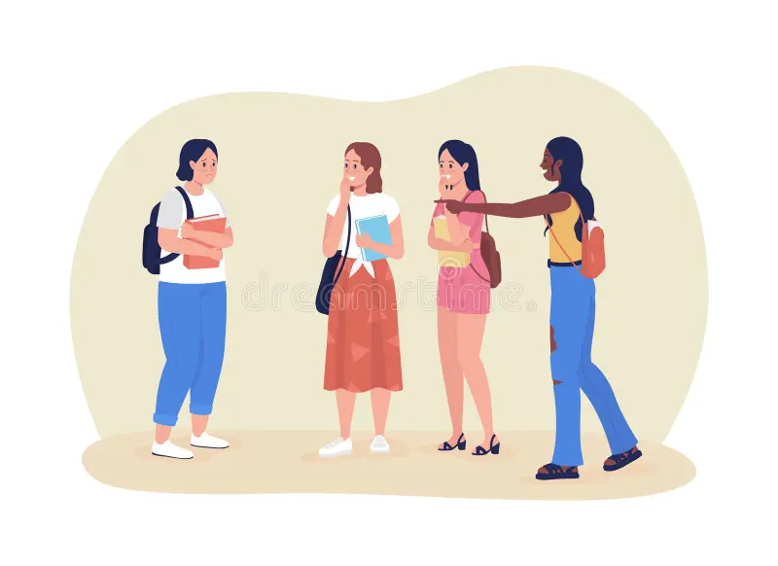
Today’s goal:
To identify and use conflict-resolution tools to solve a peer conflict in a positive way

Slide 6
WHAT IS CONFLICT?
A MISUNDERSTANDING or DISAGREEMENT which causes an emotional reaction between TWO OR MORE connected people who NEED OR WANT something from one another.

Slide 7
What are some common examples of conflict in middle school?
What usually makes it worse?
What actually helps?

Slide 8
Have you ever seen someone (in real life or on TV) who did a great job at responding to conflict? What did they do?

Slide 9
UNHELPFUL TOOLS
Yelling
Ignoring the person forever
Gossiping
Posting online
Getting other people involved
Being passive aggressive
Threatening
Interrupting
Why might it feel easy to respond with unhelpful tools when you’re in the middle of a conflict?

Slide 10
HELPFUL TOOLS WHEN RESPONDING TO CONFLICT
LISTENING!
COMPROMISE
01
04
I STATEMENT
ASK FOR HELP
02
05
TAKE A PAUSE
PERSPECTIVE
06
03
Let them finish speaking before taking your turn, do not interrupt
Finding a solution where both people feel heard
name feelings and needs instead of attacking (e.g., "I feel upset when...").
Ask an adult for help if needed
pause to calm down and return when ready.
Try to UNDERSTAND where the other person might be coming from

Slide 11

Let’s Play a Game!
https://jeopardylabs.com/play/conflict-resolution-jeopardy-449
How to Play
Get into 2–3 teams.
Each turn, one person from the team will choose a category and point value (example: Identify the Tool for 300).
Your team must work together to come up with ONE answer. Everyone should agree before answering.
Once the whole team agrees, the person who chose the question will share the final answer.
If the answer is incorrect, the next team will have a chance to steal.
Teams should listen respectfully while others are answering.
Bonus points may be awarded for thoughtful explanations, role play effort, or using conflict resolution vocabulary.

Slide 12
Wrap Up/Exit Ticket
What’s one helpful tool you think you will use in the future?
OR
What’s one tool you think is hardest to use in real life?

Slide 13
Write down one conflict you have run into in middle school
(or an example you MIGHT run into)

Slide 14
Activity
01
02
03
Get in groups of 2-3
Pick Scenario
Come up with 2 versions
(5 min)
Role play a healthy version using helpful tools and an unhealthy version using unhelpful tools

Slide 15
EXAMPLE
Your friend who comes over to your house all the time did not invite you to their birthday party
You're a lousy friend. You didn't even invite me to your birthday party! I have you over to my house all the time and you couldn't even invite me to one stupid party! I bet it was rotten anyway. You never know how to have fun
Why don't you shut up! Who cares what you think anyway? It was a great party but you have no idea how to have fun. You always make trouble. You would have ruined my party if I invited you!
I felt really hurt when I heard that you had a birthday party and didn't even invite me because I thought we were good friends . It doesn't seem like something a good friend would do. When Pam and Keisha told me they were invited and you didn't invite me I figured we aren't friends anymore.
I'm sorry I couldn't invite you to my party. My mom said I could only invite two friends because all of my cousins were coming. I wanted to talk to you before the party but I didn't know how to tell you because I felt so bad. I would really like to stay friends.

Slide 16
SCENARIO 1
While getting ready for school, you notice your favorite sweater is missing. You figure your younger sister borrowed it, so you ask her where it is. She reluctantly pulls it out from under her bed, with a big stain on the front of it.
SCENARIO 2
You and your best friend have plans for the weekend, and you've been looking forward to hanging out all week. On Friday afternoon, your friend tells you you’ll have to do it another time because he's doing something with someone else.
SCENARIO 3
When you come home from school, your mom is upset because she thinks you broke her favorite vase without telling her about it. She automatically grounds you, but you know it was actually your brother who did it.
SCENARIO 4
A classmate has asked you for the twentieth time to borrow a pen. Every time you lend her one, you don’t get it back, so this time you say no. She gets angry and starts to yell at you.

Slide 17

Now…who wanna share their skit??

